Slide 1
FALL REDUCTION ON THE ADVANCED CARE UNIT
Sam Clark, RN, MSN-c, PCCN
NURS 653: CNL Role: Synthesis
*Reduction of falls on the unit by 25% by the end of CY 2015*
1

Slide 2
GLOBAL AIM:
We aim to improve the treatment of patients by decreasing falls by 25% by the end of 2015 in Providence Holy Family Hospital. The process begins with the initial notification of the need for patient admission. The process ends with the patient reaching the appropriate goals for discharge by not delaying the discharge due to a fall. By working on the process, we expect to (1) not delay planned patient outcomes, (2) improve patient safety, (3) improve/increase frequency of patient monitoring, (4) improve teamwork, (5) limit the amount of stress on the patients, families and staff following a fall with a worsening possible condition. It is important to work on this now because with the aim to improve (1) satisfaction of patients, families and staff, (2) increase process knowledge of nursing staff, (3) decrease the number of patients having any adverse outcomes.
2

Slide 3
SPECIFIC AIM:
We aim to indentify any and all patients that are at a high risk of all falling during their admission and throughout their hospital stay until discharged.
3

Slide 4
FISHBONE DIAGRAM
PHYSICAL ENVIRONMENT
PATIENTS
Confusion (Acute or Chronic)
Low Lighting
Not Knowing Limitations
No Bed Alarms
New Medications/Sedating
Far Distance Between Rooms
Acutely Ill Patient
Why falls have been happening on the ACU over the last 32 months.
Not all staff is aware of process
Ineffective Rounding (Not consistently done)
Not Updated
Inexperienced Staff
Not EBP followed
Numerous new staff
Not Followed
High Turnover of Staff
PROCESS
STAFF
4

Slide 5
PROCESS MAP
Phone call to unit for admission to ACU
Charge Nurse identifies RN to take the patient
Report Received/Orders & History Reviewed
Arrival to the unit, appropriate patient placement
(ie. Confused vs. A&O)
Potential Delay of arrival to the unit
Confused vs. A&O
Nurse admits patient to the unit
Plan
DC
Evaluation
Invention & Treatment
5

Slide 6
SWOT ANALYSIS
Strengths:
Staff has a vested interested in decreasing falls on the unit.
b. Discussion of high risk patients for falls at the beginning of shifts so as to focus on these rooms when necessary.
c. Bed alarms on those patients who are confused and that the high risk patients are usually placed near a nurses station so as to have more hands available.
Weaknesses:
a. Place a bed alarm on an alert and oriented patient who may not know their limitations, but still refuses to call for help when they want to use either the bathroom or bedside commode (BSC).
b. Consistency by all staff on all shifts in vigilance in answering call lights and responding quickly to bed alarms.
6

Slide 7
SWOT ANALYSIS CONTINUED...
Opportunities:
a. Let patient’s know that we value their safety while they are on the unit and to let them know to use the call light, especially if they are connected to an intravenous line, sequential compression devices or Foley catheter’s to name a few
b. Improve the communication for all the staff in regards to patient safety, and let your buddy and aide know who you have concerns about
Threats:
a. The threat I have seen by all hospital personnel is complacency, especially since we have new Hill-Rom beds and sometimes the alarm just goes off. Some staff members have crawled into their own bubble and don’t like responding to lights that are not their own.
7

Slide 8
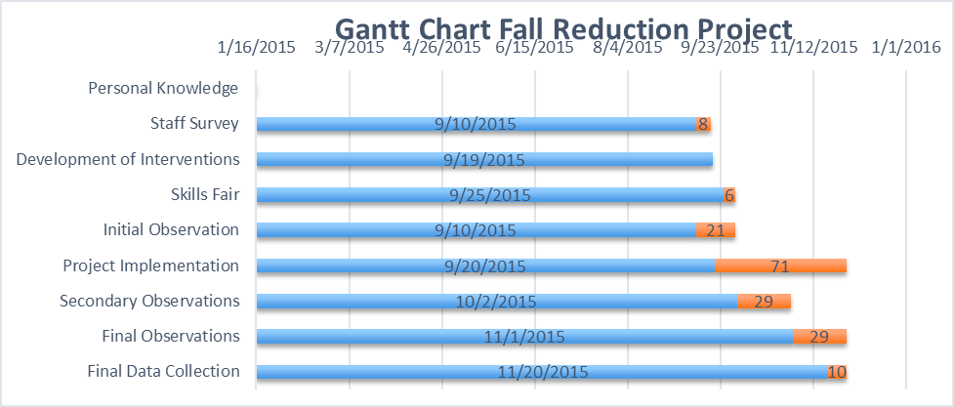
GANTT CHART / TIMELINE
8

Slide 9
Sustain
Plan
Study
Do
Act
Keep program going
Survey Results
Discuss with Staff
Implement Survey Changes
Continue
Plan
Study
Do
Act
Suggestions from staff
Get changes ready for staff
Implement ANY changes
Staff Buy-IN
Implement
Plan
Study
Do
Act
Organize Research
Info to ALL staff members
Discuss Importance
Bed Alarms, More rounding
Initiate
Plan
Study
Do
Act
Surveys
Survey Results
Organize ALL Research
Research
Keep project going
by continual evolution!
Staff Huddles/Continue Reassessment of Patients.
How to get the information out to the staff.
What does the staff want to cover?
9

Slide 10
REFERENCES:
AACN End-of-Program Competencies & Required Clinical Experiences for the Clinical Experiences for the Clinical Nurse Leader. (2006).
Retrieved on 30 September 2015 from: http://www.aacn.nche.edu/cnl/CNL-Competencies-October-2013.pdf
rossey, L.A. & March, K.S. (2015). Effectiveness of Structured Hourly Nurse Rounding on Patient Satisfaction and Clinical Outcomes. Journal Of Nursing Quality, 30(2), 153-159. doi:10.1097/NCQ.0000000000000086.
Cangany, M., Back, D., Hamilton-Kelly, T., Altman., & Lacy, S. (2015). Bedside Nurses Leading the Way for Falls Prevention: An Evidence-Based Approach. Critical Care Nurse, 35(2), 82-84. doi:10.4037/ccn2015414.
Evidence for practice. Association of patient falls with nurse staffing and hospital magnet status. (2012). AORN Journal, 95(2), 297-298.
Hicks, D. (2015). Can Rounding Reduce Patient Falls in Acute Care? An Integrative Literature Review. MEDSURG Nursing, 24(1), 51-55.
Kotter International. (2015). The 8-step process for leading change. Retrieved on 6 October 2015 from: http://www.kotterinternational.com/the-8-step-
process-for-leading-change.YouTube.
Krepper, R., Vallejo, B., Smith, C., Lindy, C., Fullmer, C., Messimer, S. &…Myers, K. (2014). Evaluation of a Standardized Hourly Rounding Processing (SHaRP). Journal For Healthcare Quality: Promoting Excellence In Healthcare, 36(2), 62-69. doi:10.1111/j.1945-1474.2012.00222.x.
10

Slide 11
REFERENCES CONTINUED…
Lake, E., Shange, J., Klaus, S., & Dunton, N. (2010). Patient falls: association with hospital magnet status and nursing unit staffing. Research In Nursing & Health, 33(5), 413-425. doi:10.1002/nur.20399.
Nazarko, L. (2015). Falls secondary to postherpetic neuralgia. Nurse Prescribing, 13(1), 44-48.
Nelson, E.C., Batalden, P.B. & Godfrey, M.M. (2007). Quality by Design: A Clinical Microsystems Approach. San Francisco, CA: Jossey-Bass.
Sampels Twibell, R., Siela, D., Sproat, T., & Coers, G. (2015). PERCEPTIONS RELATED TO FALLS AND FALL REDUCTION AMONG HOSPITALIZED ADULTS. American Journal Of Critical Care, 24(5), e78-85. doi:10.4037/ajcc2015375.
Woodward, J. (2009). Effects of rounding on patient satisfaction and patient safety on a medical-surgical unit. Clinical Nurse Specialist: The Journal For Advanced Nursing Practice, 23(4), 200-206.
11

Slide 12
ACKNOWLEDGEMENTS:
*First and foremost my family who has put up with me over the last two years and giving me the love and support that I needed to get through all of this.
*My professors for guiding me through all of the classes and giving me the tools that I needed to succeed both in the classroom and once I have graduated.
*All my fellow classmates and their invaluable input through all of these classes. Best of luck to everyone!
*My preceptors who have helped open my eyes over the many projects and giving me the confidence to complete them and to grow.
*Coworkers who put in their ideas for my final project and to give it 100% when implementing fall prevention on the ACU.
12

