Slide 1
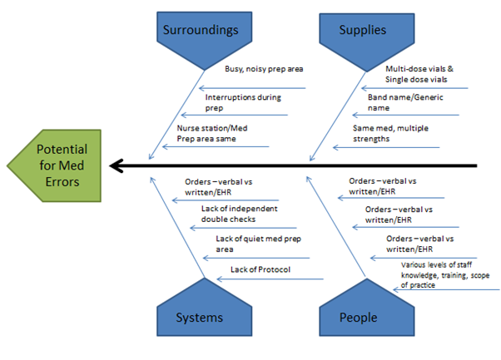
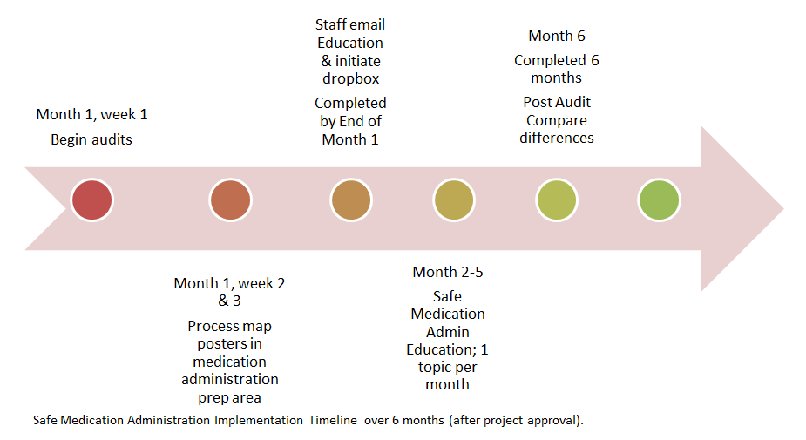
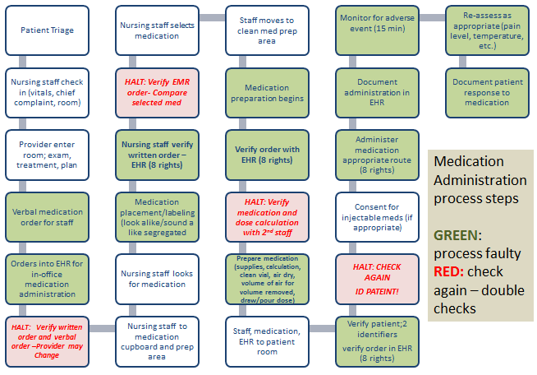
Outpatient Medication Error Improvement
Savannah M. Klinginsmith, RN, MSN-CNL Student
Patient Safety Initiative – Improving Medication Administration
Congress mandated the Institute of Medicine (IOM) to “carry out a comprehensive study of drug safety and quality issues in order to provide a blueprint for system-wide change” (IOM, 2003).
Background
Fishbone Diagram
Supportive Theory
Implementation Plan & Timeline
Microsystem consisting of 14 urgent care & family practice combination clinics
Recognition of staff not knowing medications and dosage calculations which lead to chart reviews
Documentation errors noted
Observation of providers and staff in medication ordering and administering process
FMEA was conducted
Research completed on best practices and medication administration errors and improvement in outpatient care
Lewin’s 3 Step Change Theory
Implementation planning includes:
Medication administration baseline audit
Staff education – steps of medication administration via email
Staff drop box for monthly medication administration education topics for staff input and buy-in for a medication process improvement campaign
Medication protocol development & revision
Protocol poster
Process poster with halt steps
Process and timeline for implementation presented to Back Office Team and Director
Clinic Administrator notification and project plan training
Un-Freeze
-Presenting project to staff with rationale for change
-Staff buy-in
Transition
-During implementation
-Develop new attitudes and behaviors for safe medication administration
Freeze
-Acceptance of new protocol
-Routine practice of protocol
SWOT Analysis
Strengths | Weaknesses
Supportive Managers & Directors Long term staff in clinic setting (strong knowledge base) Consistent medication type in each clinic Limited number of medication options (20) Small company Desire for patient safety | Limited staff (administrative & nursing) resources Limited time/focus – too many projects at the same time Variation in clinic set-up; confusing staff Medication prep area is at the nurses station
Opportunities | Threats
Additional support for change/improvement Detailed policies Communication channels through established monthly meetings & email | Variation in staff license, training and scope of practice Busy (10 patients at the same time, phone calls) Emergencies
Summary of Evidence
Research data shows that the following can improve the safety of medication administration in the outpatient care settings:
Improve medication reconciliation
Have current medication references available
Standardize medication measuring products
Staff Education: calculations, dosing, and reconstitution
Facilitate and improve communication between providers and staff; order clarification
Develop and implement safe processes and protocols for improved safety
[Abramson et al (2012), Bernstein et al (2011), Forster and Auger (2013), Mehndiratta (2012), Neuss (2013)]
Supportive Data-
Process map shows evidence based steps for medication administration
Fishbone diagram displays flaws and failures in the system
400-600 medications administered each day in the microsystem
Results & Recommendations
Project on hold – allow for flexibility in the timeline
Results show if proactive in medication safety – error prevention
Recommend to continue with the project when it is feasible to do so
Business Case
Estimated 260-280 CNL hours at range of $25-$30/hour
Staff Training estimated 4-6 hours at range of $16-22/hour
Expenditures are proactive in error prevention
Network for Excellence in Health Innovation estimates 16.4 billion dollars of preventable errors occur in the outpatient setting annually
Team collaboration for patient safety
Standard of care based on national initiatives
Engage Staff
Theoretical
Direction
Process Map
References: Available upon request

