Slide 1
Medication Transcription Error Prevention
University of San Francisco
N653 Internship: Clinical nurse leader
Angela Huang

Slide 2
SPECIFIC AIM
We aim to improve the medication transcription process for new patients. We will have 100% participation from all staff by December, 2014.

Slide 3
BACKGROUND
The rehabilitation center is a for-profit agency with a client population ranging from ages 35-80 with various diagnoses.
Staffing in the microsystem in a shift consist of a nurse manager, registered nurses, licensed vocational nurses, and nursing assistants.
New patients are often admitted short term and will often require some form physical therapy and nursing interventions.

Slide 4
SUPPORTIVE DATA
A Failure Mode Effect Analysis (FMEA) was conducted to accurately assess the severity and probability rate of transcription errors.
The analysis revealed high probability and severity scores in wrong dose, wrong medication and order not received failure modes during the transcription process.
Process Function | Failure Modes | Causes | Effects | Severity | Probability | Action to Reduce Failure Mode
Medication transcription | Wrong dose Order not received Wrong medication Wrong route | Lack of knowledge on medication. Illegible written orders. Omitting order Unable to clarify order with physician Use of substitute drug | Overdose or under-dose Patient condition not controlled Adverse drug event. Allergic response Overdose or under-dose. | 3 2 2 2 | 3 3 3 2 | Omission of abbreviations Guidelines to incorporate double checking of medication with a second nurse Provide additional time to recheck medication and recalculate dosages Provide guidelines to create checklist in the transcriptions process

Slide 5
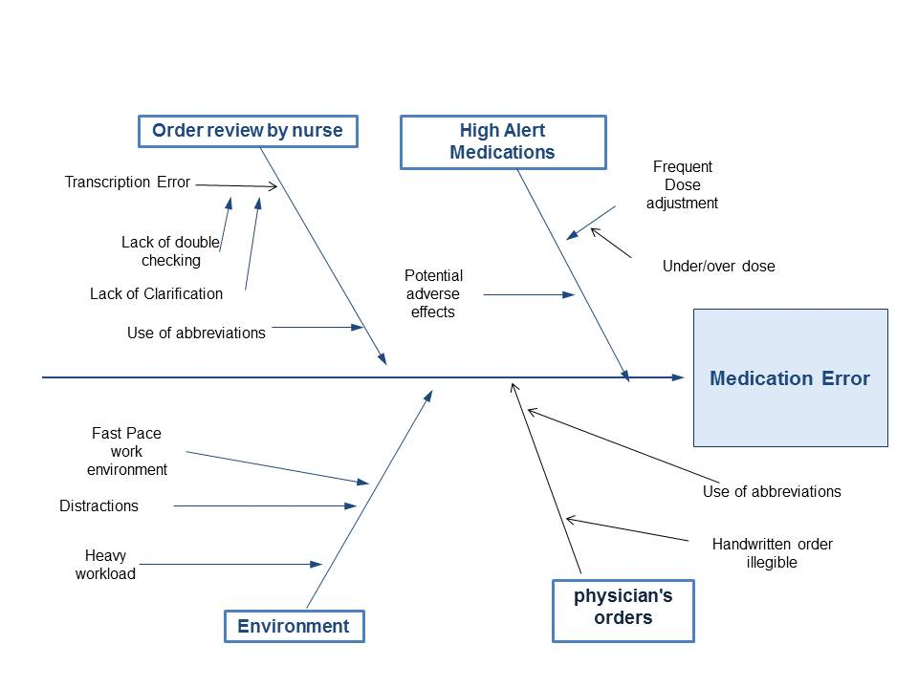
SUPPORTIVE DATA (cont.)
The fishbone diagram indicates issues that contribute to medication errors.
The two issues that will be addressed in the project in the fishbone diagram are orders reviewed by nurses and high alert medications.

Slide 6
SWOT ANALYSIS
Internal factors that are contributory to the specific aim are knowledgeable staff that can provide guidance and leadership to other staff members during new processes and the commitment to patient safety among unit members.
External factors such as staff shortages and staff turnovers can impact patient outcomes and staff morale.
Internal | STRENGTHS The unit is committed to improving patient safety Knowledgeable staff Standard guideline in place for patient admission Reducing medical errors | WEAKENESSES Staff may resist implementation of new strategies High pace work setting can contribute to errors Lack of funding for additional staff Reduce productivity during the implementation phase
External | OPPORTUNITIES Better patient outcomes Increase efficiency during admissions Improve communication between staff and other departments Improve reputation Enhance policy through improve guidelines | THREATS Lack of organization support Staff turnovers Staff shortages Strategies may not be effective as expected

Slide 7
SEARCH STRATEGIES
All journals are articles searched are peer reviewed
The dates of the articles range from 2006 to 2013 and are timely relevant to the issue.
Search phrases predominately used were medication transcription error and medication safety. Both quantitative and qualitative articles are accepted.

Slide 8
SUMMARY OF EVIDENCE
In the article “Medication error prevention for healthcare provider” Chilton (2006) identified strategies that can be used to prevent mediation errors.
In the article “Medication errors: what hospital reports reveal about staff views” Harkanen, Turunen, Saano, & Vehvilainen-Julkunen (2013) asserts that errors can be prevented by improving work environments.
Baker, K (2008) in the article “Reducing your risk: Reducing medication errors requires a non-punitive approach” asserts that a non-punitive approach can collect data that can be used to identify vulnerabilities in the system and prevent future errors.

Slide 9
TIMELINE
A FMEA was conducted in November, 2013 to study problems that may arise during the transcription process.
Data collection to validate project (9/1/14-9/15/14)
Develop guidelines and medication safety principles (9/16/14-9/29/14)
Staff teaching (9/30/14-10/13-14)
Project implementation (10/20/14-11/20/14)
Evaluation (11/24/14-11/28/14)

Slide 10
TIMELINE (cont.)

Slide 11
RESULTS
The chart audits indicated a participation rate of 80%
55 charts were reviewed, of which 44 followed study guidelines.
The survey indicated an overall positive attitude on the testing strategies.
8 nurses surveyed, 6 with positive feedback, 2 did not participate due to reduce productivity and lack of time.

Slide 12
RECOMMENDATION
Second PDSA cycle at a larger scale
Revise educational tools to increase staff participation
Maintain effective communication channels
Improve collaboration and communication within the unit
Continue to perform evidence-based research ensure best practice

Slide 13
REFERENCES
Fahimi, F., Nazari, M., Abrishami, R., Sistanizad, M., Mazidi, T., Faghihi, T.,…Baniasadi, S. (2009). Transcription errors observed in a teaching hospital. Retrieved from: http://www.ams.ac.ir/AIM/NEWPUB/09/12/2/0014.pdf
Chilton, L. (2006). Medication error prevention for healthcare providers. Retrieved from: http://www.medscape.org/viewarticle/550273
Choo, J., Hutchinson, A., & Bucknall, T. (2010). Nurse’s role in medication safety. Journal of Nursing Management, 18 (7): 853-61. Retrieved from: http://0-dx.doi.org.ignacio.usfca.edu/10.1111/j.1365-2834.2010.01164.x
Murphy, E., Oxencis, Klauck, J., Meyer, D., & Zimmerman, J. (2009). Medication reconciliation at an academic medical center: Implementation of a comprehensive program from admission to discharge. American Journal of Health-System Pharmacy, 66 (23): 2126-31.Retrieved from: http://0dx.doi.org.ignacio.usfca.edu/10.2146/ajhp080552
Harkanen, M., Turunen, H., Saano, S., & Vehvilainen-Julkunen, K. (2013). Medication errors: what hospital reports reveal about staff views. Nursing Management-UK, 19 (10): 32-7. Retrieved from: http://0-web.a.ebscohost.com.ignacio.usfca.edu/ehost/pdfviewer/pdfviewer?sid=9829db21-4859-4c1c a8b9-7ef56b07afe9%40sessionmgr4001&vid=5&hid=4114
Schaumburg, I. (2010). Study: Medical errors cost U.S. economy almost $20 billion in '08. Retrieved from: http://www.healthcarefinancenews.com/news/studymedical-errors-cost-us-economy-almost-20-billion-08

