Slide 1
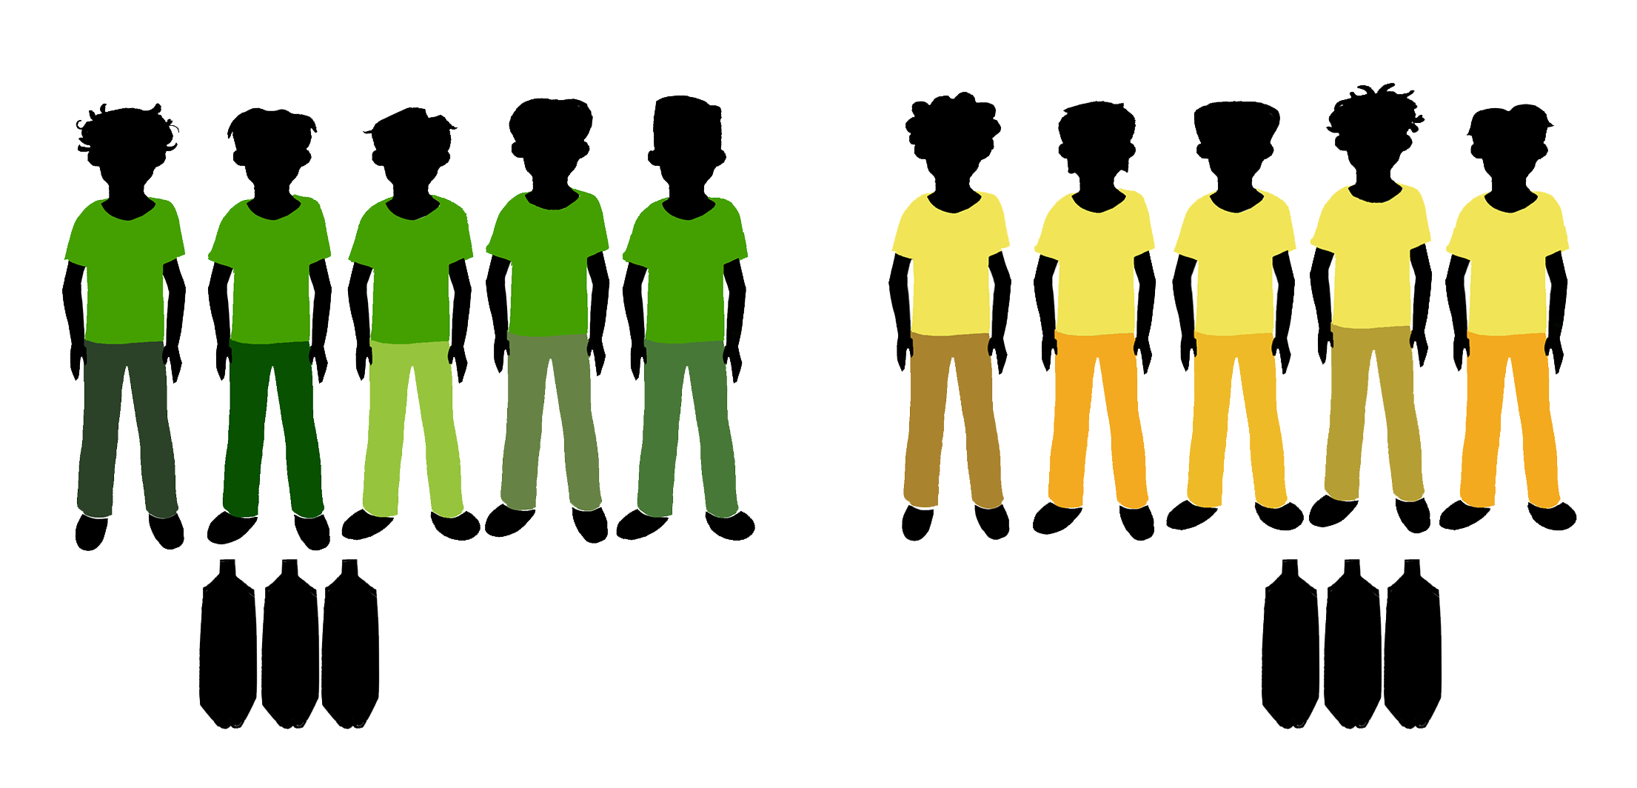
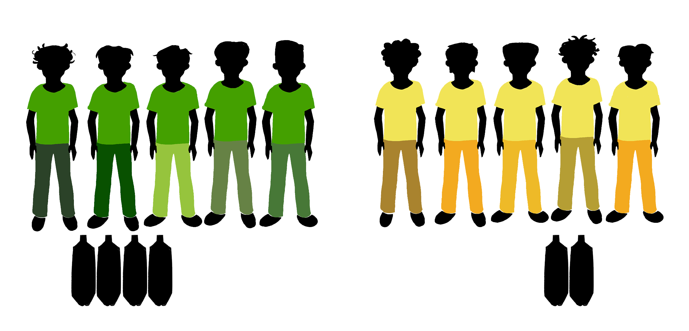
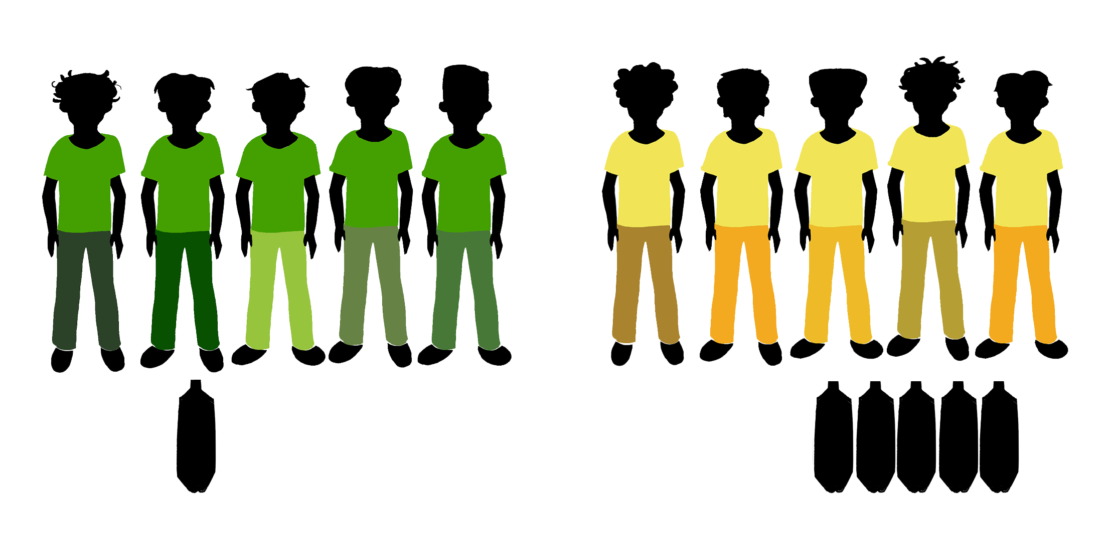
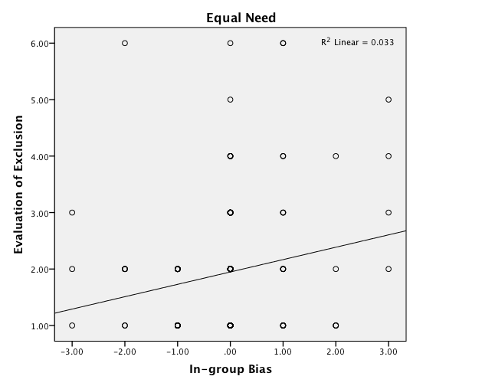
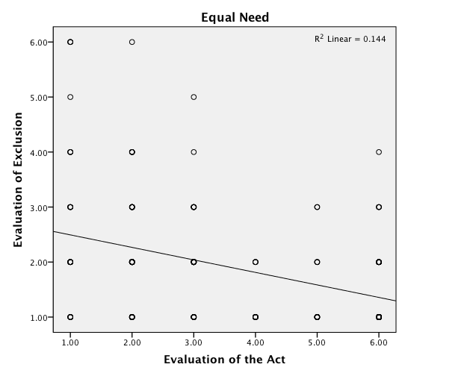
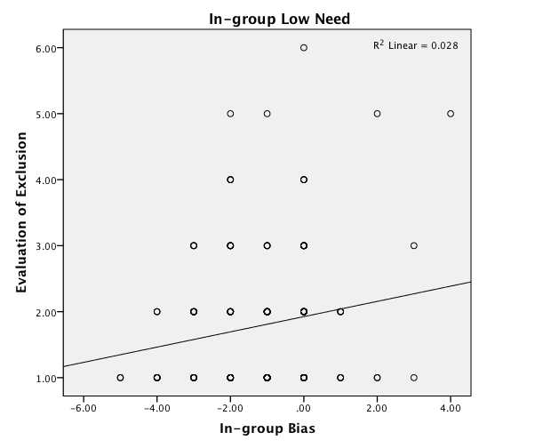
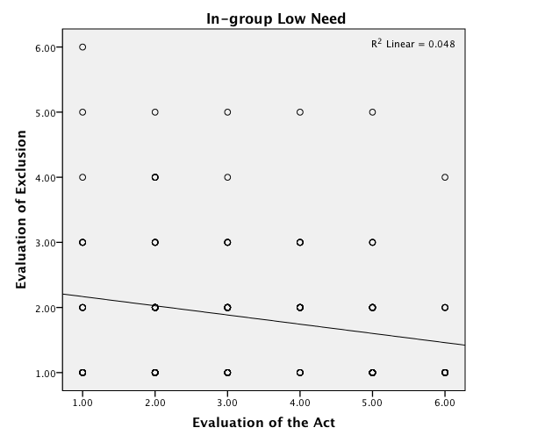
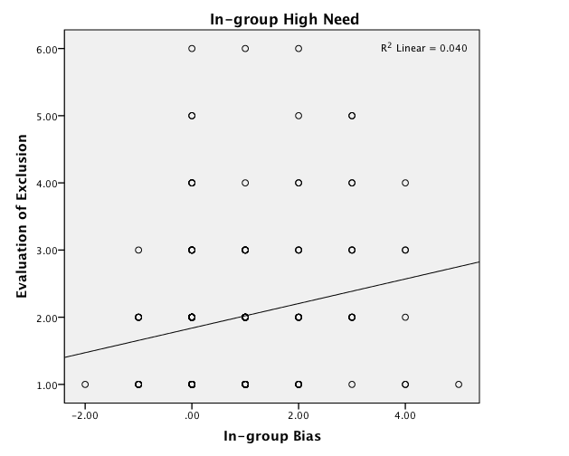
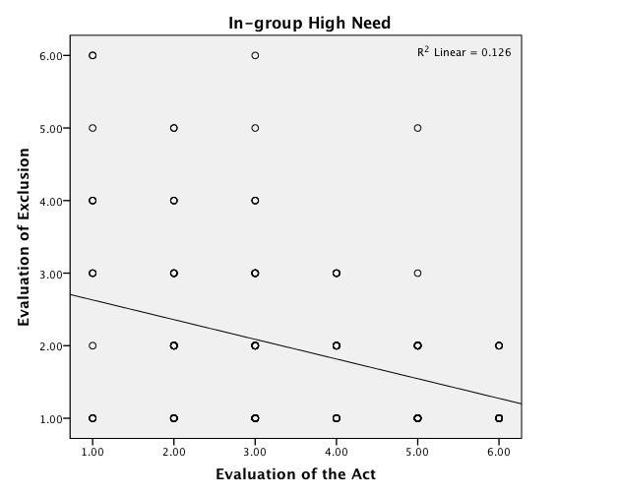
Children’s evaluation of excluding an in-group member who help out-groups
Janel Cuevas, Lily Samiee, Makeda Mayes, Santiago Gonzalez,
Ariel Kasoff, Annabelle Farina, Sabrina Ortiz, Aline Hitti
Introduction
Measures
Conclusion
Past research indicate that children and adolescents are often not willing to exclude in-group members, but might be more willing if an in-group member challenged moral group norms (i.e., splitting the water equally) by instead giving more to their own group (Hitti, Mulvey, Rutland, Abrams, & Killen, 2013).
Past research within social development revealed that when given the choice between an in-group member and an out-group member, children are more likely to help an in-group member, however, they are willing to help an out-group member if they are in need (Sierksma, Thijs, and Verkuyten, 2015).
Less is known about exclusion of in-group members who distribute resources in ways that come at a cost to one’s own group (i.e. giving away more resources to an out-group when the in-group needs it more).
In the current study we examined whether in-group bias and approval of a helping act by an in-group member predicted children’s and adolescents’ approval of excluding that member.
In-group
Out-group
In-group
Out-group
In-group
Out-group
While overall children and adolescents were not approving of excluding an in-group bias was positive associated with approval of exclusion, especially when both groups needed equal amounts of water and when the in-group did not as much water as the out-group.
How approving participants were of the helping act by their in-group member was the strongest predictor of exclusion.
These findings held true controlling for gender, age, and the type of helping.
Distribution 1:
Helping the out-group equally as the in-group
Distribution 2:
Helping the out-group less than the in-group
Distribution 3:
Helping the out-group more than the in-group
Evaluation of Exclusion:
“How okay or not ok do you think it is that the the group decides that they do not want Sam in the group anymore?”
1 = Really Not Okay, to 6 = Really Okay
Evaluation of the helping act:
“How okay or not okay was it for Sam to do what he did?”
1 = Really Not Okay, to 6 = Really Okay
In-group Bias:
(“How important it was to give water to the in-group?”) - (“How important it was to give water to the out-group?”)
Results
Discussion
Table 1
Results of the Multiple Regression Analyses for Approval of Exclusion
Predictors |  | t |  | p | B | F | df | p | Adj. R²
Equal Need |  |  |  |  |  | 8.955 | 5 | 0.000 | 0.181
Gender |  | -0.790 |  | 0.431 | -0.055
Age |  | 0.836 |  | 0.404 | 0.058
In-group Bias |  | 2.882 | ** | 0.004 | 0.198
Distribution |  | 0.722 |  | 0.471 | 0.049
Evaluation of the Act |  | -6.021 | *** | 0.000 | -0.411
In-group Low Need |  |  |  |  |  | 2.652 | 5 | 0.018 | 0.049
Gender |  | -0.181 |  | 0.857 | -0.014
Age |  | 0.292 |  | 0.771 | 0.022
In-group Bias |  | 2.167 | * | 0.032 | 0.160
Distribution |  | 0.433 |  | 0.666 | 0.037
Evaluation of the Act |  | -2.806 | ** | 0.006 | -0.240
In-group High Need |  |  |  |  |  | 5.92 | 5 | 0.000 | 0.124
Gender |  | 0.550 |  | 0.583 | 0.040
Age |  | -0.039 |  | 0.969 | -0.003
In-group Bias |  | 1.938 |  | 0.054 | 0.141
Distribution |  | 1.042 |  | 0.299 | 0.100
Evaluation of the Act |  | -2.622 | * | 0.010 | -0.254
* p<.05, ** p<.01, *** p<.001
These findings provide insight on how peer group exclusion occurs in childhood and adolescence.
While children and adolescents are more likely to exclude a peer based on that peers behavior, in-group bias can play a role in low stakes situations.
This study can be expanded to understand when children and adolescents may exclude others in contexts of actual groups, such as those based on race/ethnicity, gender, SES, and sexual orientation.
Figure 1. Equal need scatter plots for evaluation of exclusion and in-group bias (left), and evaluation of the act (right)
Methodology
Participants:
183 4th and 8th graders
(M_{age} = 11.14, SD = 1.93)
61% Female
Vignettes:
The children and adolescents responded to three different stories regarding an in-group member helping an out-group member by distributing out the water he/she found: 1.) helped the out-group and the in-group equally, 2.) helped the out-group less than the in-group, and 3.) helped the out-group more than the in-group.
References
Hitti, A., Mulvey, K. L., Rutland, A., Abrams, D., &
Killen, M. (2013). When is it okay to exclude
a member of the in-group? Children’s and
adolescents’ social reasoning. Social Development, 23(3),
451-469. doi:10.1111/sode.12047.
Sierksma, J., Thijs, J., & Verkuyten, M. (2014). Children’s intergroup helping: The role of empathy and peer
group norms. Journal Of Experimental Child Psychology, 126369-383. doi:10.1016/j.jecp. 2014.06.002.
This study was funded by the University of San Francisco Faculty Development Fund awarded to Aline Hitti, Ph.D.
Three linear regression models were tested with the approval of exclusion as the dependent variable. Predictors were in-group bias and evaluation of the helping act,. Gender, age, and type of distribution were control variables.
Findings indicated that when both groups had equal need and when the in-group had low need, in-group bias and evaluation of the helping act both predicted how approving participants were of excluding the helping in-group member (see Table 1).
When the in-group had high need for the water, how participants evaluated the helping act was most predictive of their approval for excluding their in-group member.
Overall, participants did not approve of excluding their in-group member (Equal Need: M = 1.94, SD = 1.09; In-group Low Need: M = 1.83, SD = 1.03; In-group High Need: M = 1.97, SD = 1.14
Figure 2. In-group low need scatter plots for evaluation of exclusion and in-group bias (left), and evaluation of the act (right)
Figure 2. In-group high need scatter plots for evaluation of exclusion and in-group bias (left), and evaluation of the act (right)

