Slide 1
Master of Science in Data Science
Deep Learning in Medical Physics: When small is too small?
Miguel Romero, Yannet Interian PhD, Gilmer Valdes PhD, and Timothy Solberg PhD
*Was partially supported by the Wicklow AI and Medicine Research Initiative at the Data Institute.
Notes:
Intersection Medical Physics & Deep Learning

Slide 2
Sections
Motivation & Problem
Experiments
Resources & Techniques
Results
Discussion

Slide 3
Sections
Motivation & Problem
Experiments
Resources & Techniques
Results
Discussion

Slide 4
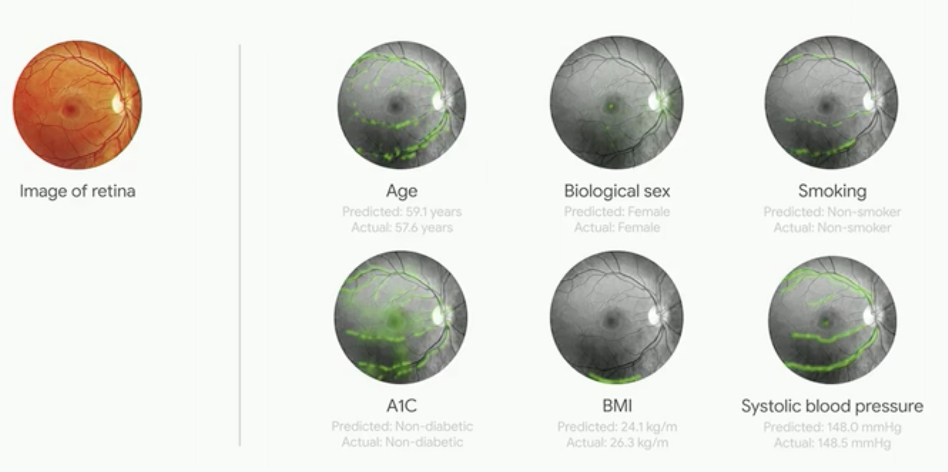
Motivation
Diagnosis Diabetic Retinopathy
Notes:
Diagnosis Diabetic retinopathy

Slide 5
Question
Is life that easy?
=
Can we do the same in our images and problems?
Notes:
Diagnosis Diabetic retinopathy

Slide 6
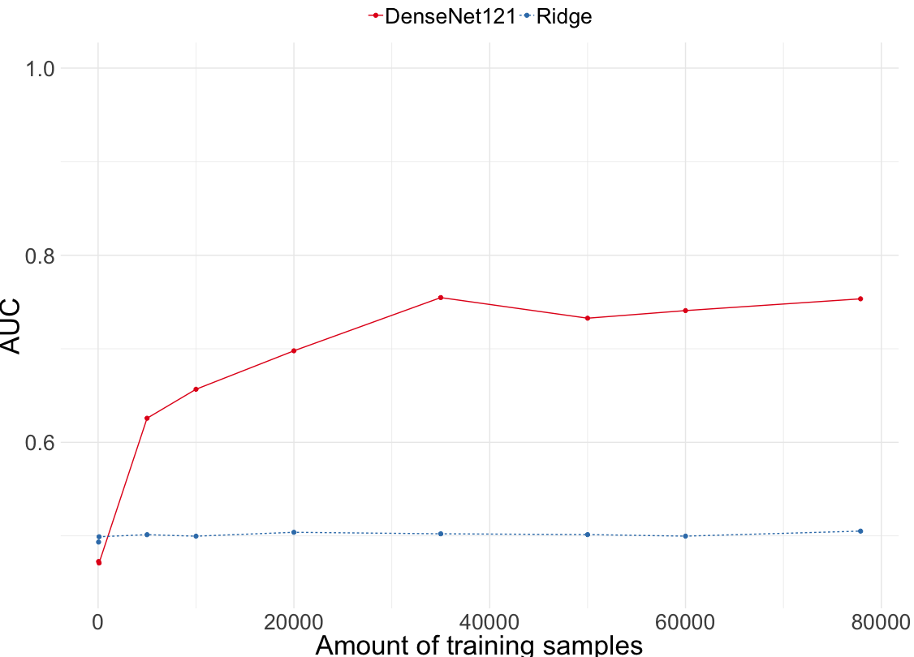
Performance as a function of the # data available

Slide 7
Performance as a function of the # data available
Medical Physics

Slide 8
Performance as a function of the # data available
DL < Ridge ?!
Notes:
But wait….
See statistician at the end of the room

Slide 9
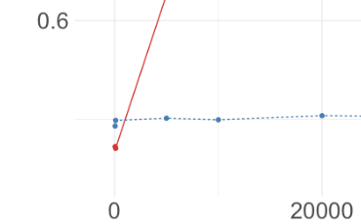
Our problem: When small data is too small?
Notes:
Can we say something about those

Slide 10
Our problem: When small data is too small?
Complexity?
Amount of noise?
Notes:
But wait….
See statistician at the end of the room

Slide 11
Sections
Motivation & Problem
Experiments
Resources & Techniques
Results
Discussion

Slide 12
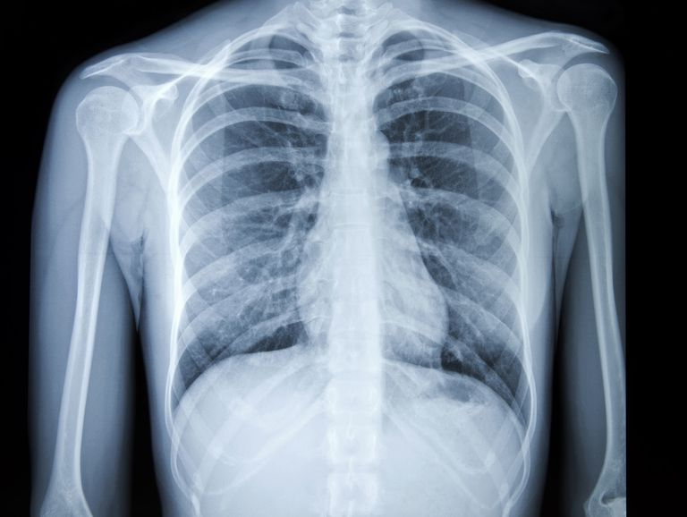
#1 Set of Tasks: "With real labels"
Notes:
Assess performance for different amounts in those ranges with different models/techniques.
Given a chest x-ray image, can we infer which ones out of 14 disease does the patient has?

Slide 13
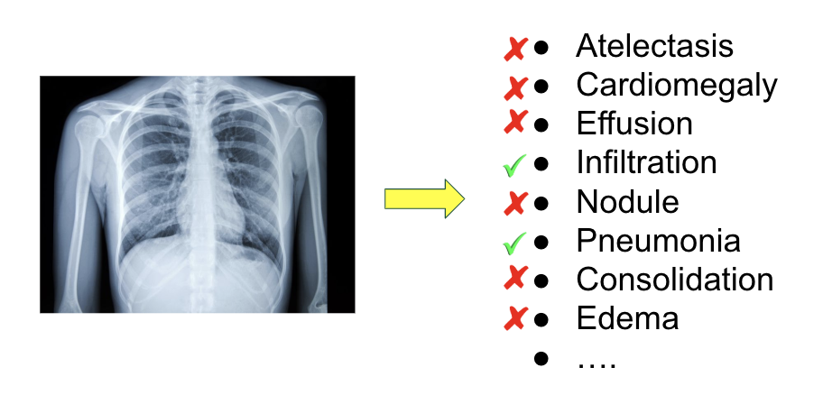
#1 Set of Tasks: "With real labels"

Slide 14
#1 Set of Tasks: "With real labels"
?
Pneumonia

Slide 15
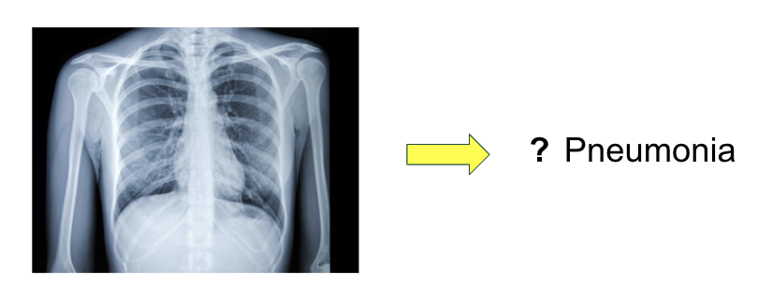
#1 Set of Tasks: "With real labels"
50
2000
# of samples
50
1600
# of samples

Slide 16
#2 Set of Tasks: "With synthetic labels"
Notes:
Complexity
Noise

Slide 17
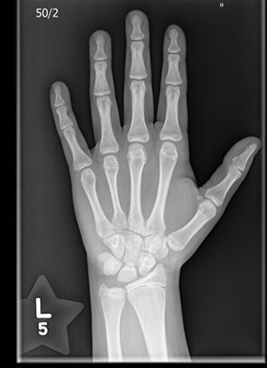
#2 Set of Tasks: "With synthetic labels"
Original Dataset
[0/1]

Slide 18
#2 Set of Tasks: "With synthetic labels"
Original Dataset
Model X
f
[0/1]

Slide 19
#2 Set of Tasks: "With synthetic labels"
Original Dataset
Synthetic Dataset
Model X
f
[0/1]
Threshold selection
&
Hard labels creation

Slide 20
#2 Set of Tasks: "With synthetic labels"
Original Dataset
Synthetic Dataset
Model X
f
[0/1]
[0/1]
Threshold selection
&
Hard labels creation

Slide 21
#2 Set of Tasks: "With synthetic labels"
Original Dataset
Synthetic Dataset
Model X
f
Model Y
g
[0/1]
[0/1]
Threshold selection
&
Hard labels creation

Slide 22
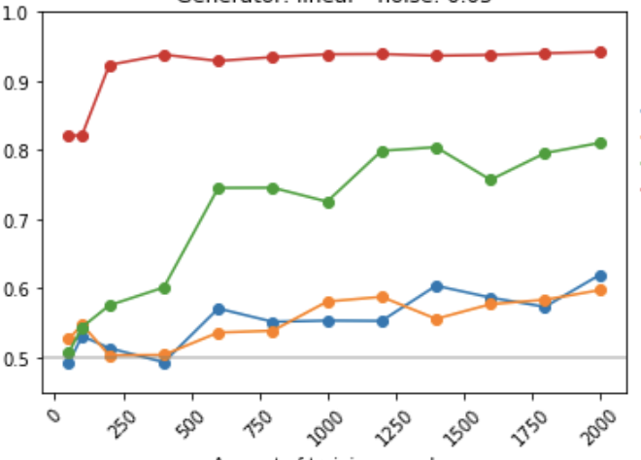
#2 Set of Tasks: "With synthetic labels"
Original Dataset
Synthetic Dataset
Model X
f
Model Y
g
[0/1]
[0/1]
Threshold selection
&
Hard labels creation
# of samples

Slide 23
Sections
Motivation & Problem
Experiments
Resources & Techniques
Results
Discussion

Slide 24
Data & algorithms
Datasets | Deep Learning | ML/Statistical models
NIH Chest X-rays → detect 14 diseases RSNA Bone Age → Detect the age (under/over) median MURA → Abnormality detection ImageNet → Image classification | ResNet 18 → 18 layers → 11M parameters ResNet 34 → 34 layers → 21M parameters DenseNet 121 → 121 layers → 9M parameters Custom CNN → 7-9 layers | Logistic Regression → 90 parameters Ridge → 90 parameters Lasso → 90 parameters Elastic Net → 90 parameters Random Forest → variable # parameters
Notes:
The specific radiomic features used were:
grey level co-occurrence matrix (GLCM) features, with 1, 2, 4, 6 pixel offset and 0, 45 and 90-degree angles (72 features/image),
grey image mean, standard deviation and second, third, fourth and fifth moment (6 features/image)
and the image entropy (1 feature/image)

Slide 25
Rough idea
Datasets | Deep Learning | ML/Statistical models
NIH Chest X-rays → detect 14 diseases RSNA Bone Age → Detect the age (under/over) median MURA → Abnormality detection ImageNet → Image classification | ResNet 18 → 18 layers → 11M parameters ResNet 34 → 34 layers → 21M parameters DenseNet 121 → 121 layers → 9M parameters Custom CNN → 7-9 layers | Logistic Regression → 90 parameters Ridge → 90 parameters Lasso → 90 parameters Elastic Net → 90 parameters Random Forest → variable # parameters
4 data-sets
≃ M parameters
≃ H parameters

Slide 26
DL techniques:
Data Augmentation
Transfer learning from ImageNet & MURA.
CNN as feature extractor
Fine tuning the CNN - all at once
Fine tuning the CNN - progressive unfreezing + differential learning rates
Training approaches (some).
Regular lr policy
One-cycle cosine with annealing lr policy and momentum
Adam optimizer
Testing Time data Augmentation (TTA)
Notes:
But wait….
See statistician at the end of the room

Slide 27
Rough idea
Data Augmentation
Transfer learning from ImageNet & MURA.
CNN as feature extractor
Fine tuning the CNN - all at once
Fine tuning the CNN - progressive unfreezing + differential learning rates
Training approaches (some).
Regular lr policy
One-cycle cosine with annealing lr policy and momentum
Adam optimizer
Testing Time data Augmentation (TTA)
Multiple ways of doing DL
Notes:
But wait….
See statistician at the end of the room

Slide 28
Sections
Motivation & Problem
Experiments
Resources & Techniques
Results
Discussion

Slide 29
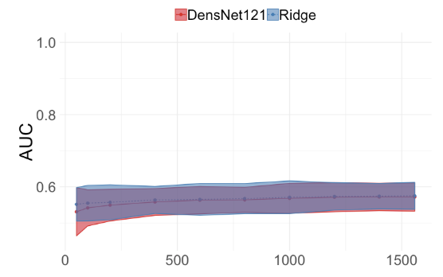
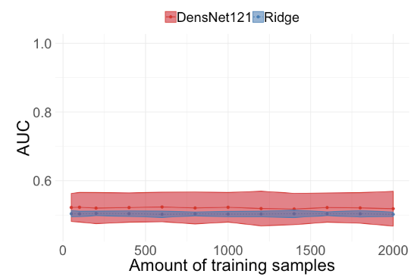
Real labels - Approach 1
DL
Linear Model
Pneumonia
14 diseases

Slide 30
Improves previous approach
Pneumonia
14 diseases
Notes:
Compare previous
Lock at the left
From the methods that we testes most of them will take a minimum of 200 samples to perform as good as a ridge.
They seem they go like a rocket.
Are NN good with 2000 samples? -> depends

Slide 31
Not that good in perspective
Pneumonia
14 diseases
Notes:
Compare previous
Lock at the left
From the methods that we testes most of them will take a minimum of 200 samples to perform as good as a ridge.
They seem they go like a rocket.
Are NN good with 2000 samples? -> depends

Slide 32
Sections
Motivation & Problem
Experiments
Resources & Techniques
Results
Discussion

Slide 33
Discussion
DL ≠ Magic.
Production level models requires large amounts of rich data.
DL seems to improve traditional approaches "earlier" in the binary balanced task.
If trained appropriately, improves traditional approaches with small data but not small enough for most medical phyisics problems.

Slide 34
Thank You,
Questions?

