Slide 1
Institutions, Game Theory, and Philosophy
Nina Macaraig

Slide 2
Institutions
Can be thought of as organizations created for fulfilling a societal purpose
Guide behaviors, encourage interactions, precluding harmful exchanges
Systematize emotions, beliefs, practices, ideas
Examples include marriage, religion, language, etc
Byproducts include rules, conventions, customs, and laws

Slide 3
Thesis
I embark on the following tasks:
An investigation of Hobbes and Hume to understand institutions in terms of civil government and property
An analysis of contemporary work pertaining to institutions and issues of collective action
An application of theoretical frameworks to modern-day technology in effort to resolve problems of human behavior
I rely on game theory and economic principles to guide my examinations.
Notes:
Wont be talking about hume in this presentation

Slide 4
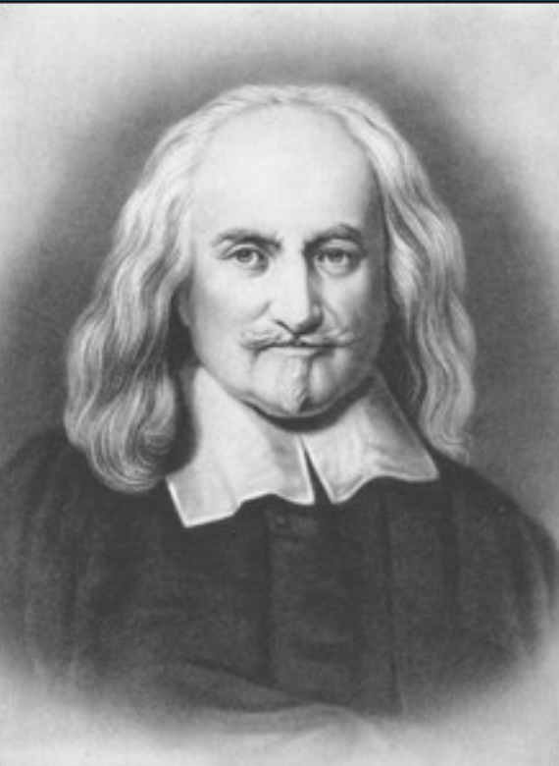
Historical
One of the thinkers I investigate is Thomas Hobbes and his Leviathan. The main points of his theory are the following:
State of Nature
Laws of Nature
The Sovereign and the Commonwealth
How the transition from 1 - 3 takes place
Notes:
Establishment of civil gov’t crucial institution
Implications of this institution - what does this permit to take place

Slide 5
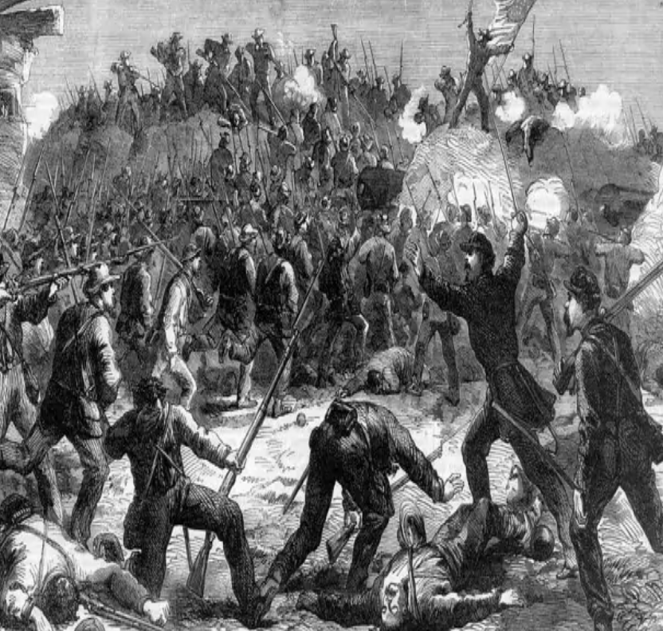
Game Theory
To Hobbes I apply a game theoretic analysis to model his SON versus Commonwealth. This requires the following assumptions:
Humans are rational agents
They are utility-maximizers
They are self-interested
People have common goals and desires for resources
Goods exist under a scarcity

Slide 6
Prisoners’ Dilemma
 |  | Player 2
 |  | Cooperate | Defect
Player 1 | Cooperate | 8,8 | 1,9
 | Defect | 9,1 | 3,3
Cooperate = coexist and work with neighbor; increases chances of survival
Defect = steal from neighbor; decrease chances of survival
Notes:
Cooperate = don’t vandalize neighbor’s property etc. but also do not have the fear that neighbor will steal property
Find Nash first, then strategy

Slide 7
Prisoners’ Dilemma
 |  | Player 2
 |  | Cooperate | Defect
Player 1 | Cooperate | 8,8 | 1,9
 | Defect | 9,1 | 3,3
Both players are led to exist at the Pareto inferior outcome
Defecting is also a strongly dominant strategy
Notes:
This is rational - define pareto inferior/superior
People are incentivized to attack their neighbor and steal his property, but this leads to everyone being worse off
Give context of state of nature

Slide 8
Problems in SON
Non-cooperation/defection is an issue without institutions
People will exist at an outcome in which they are worse off, given the assumptions that they are rational agents and utility maximizers
Dominant strategy is to defect
Communication has no bearing and alone cannot encourage cooperation
Implication: Without at least some central institution to enforce rights and incentivize behaviors, people will move to a lower equilibrium on the payoff matrix

Slide 9
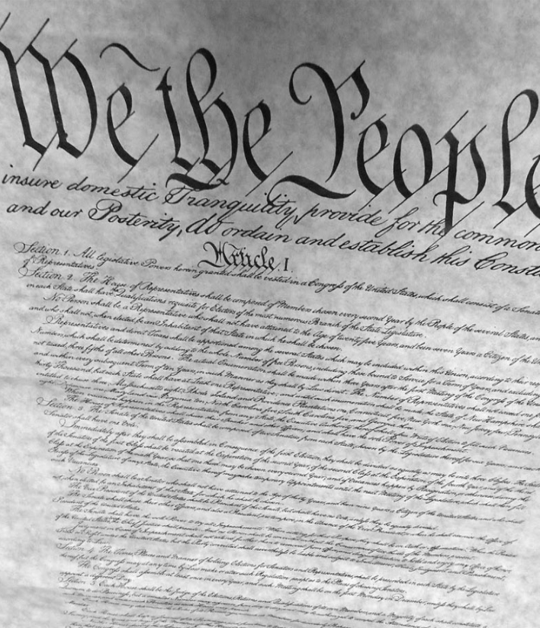
The Commonwealth
The only way to transition out of a State of Nature is to create social contracts and recognize some form of a central institution for enforcement - Social Contract Theory
This means changing the payoff structure such that people will want to cooperate with one another

Slide 10
A Cooperation Game
 |  | Player 2
 |  | Cooperate | Defect
Player 1 | Cooperate | 8,8 | 4,2
 | Defect | 2,4 | 3,3

Slide 11
The Commonwealth
Outcome in the Commonwealth is Pareto superior, with the strongly dominant strategy being to cooperate
 |  | Player 2
 |  | Cooperate | Defect
Player 1 | Cooperate | 8,8 | 4,2
 | Defect | 2,4 | 3,3
Notes:
Nash is upper left - you don’t have fear that neighbor will steal your property, etc.
DS is to cooperate - if player 2 cooperates and player 1 defects, bad in the context of commonwealth - player 1 goes to jail or gets a fine and player 2 experiences inconvenience
Nash is pareto optimal

Slide 12
The Commonwealth
When there is some form of a central institution precluding certain behaviors (stealing, attacking neighbor, etc.), people will be incentivized to cooperate and will move to a Pareto optimal equilibrium
In the real world this means people will respect their neighbor’s property and create efficiency in production (patents, etc.)

Slide 13
II. Contemporary Ideas
Norms
Coordination
Goods
Prisoners’ Dilemma
Notes:
If time permits - Hardin, Oppenheimer, Margalit

Slide 14
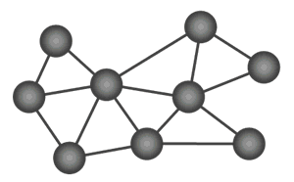
III. Modern Applications
This idea of using institutions translates into modern-day, where we can implement certain technologies to correct for issues of defection/non-cooperation.

Slide 15
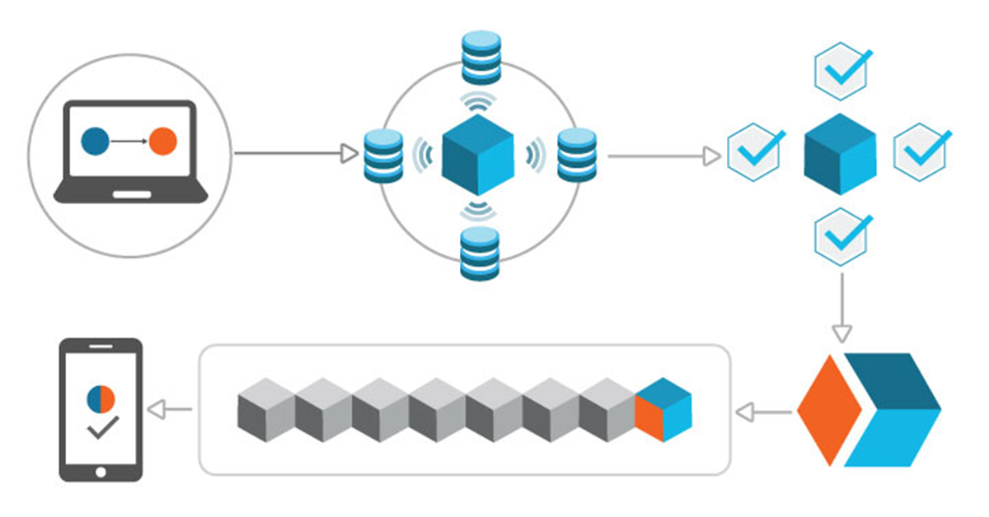
Modern-day Solutions
Notes:
Blockchain: definition, use-cases

Slide 16
How Blockchain Functions as an Institution
This technology creates a sense of trust between parties, and enforces interactions securely and accurately. It mitigates any defection that may prevent or occur within a mutually improving exchange.
Notes:
Refer to essay

Slide 17
IV. Conclusion
Problems of non-cooperation/defection exist due to incentive structure
Institutions can correct for some of these troubles
Technology as a viable solution and institution
Notes:
Recap

