Slide 1



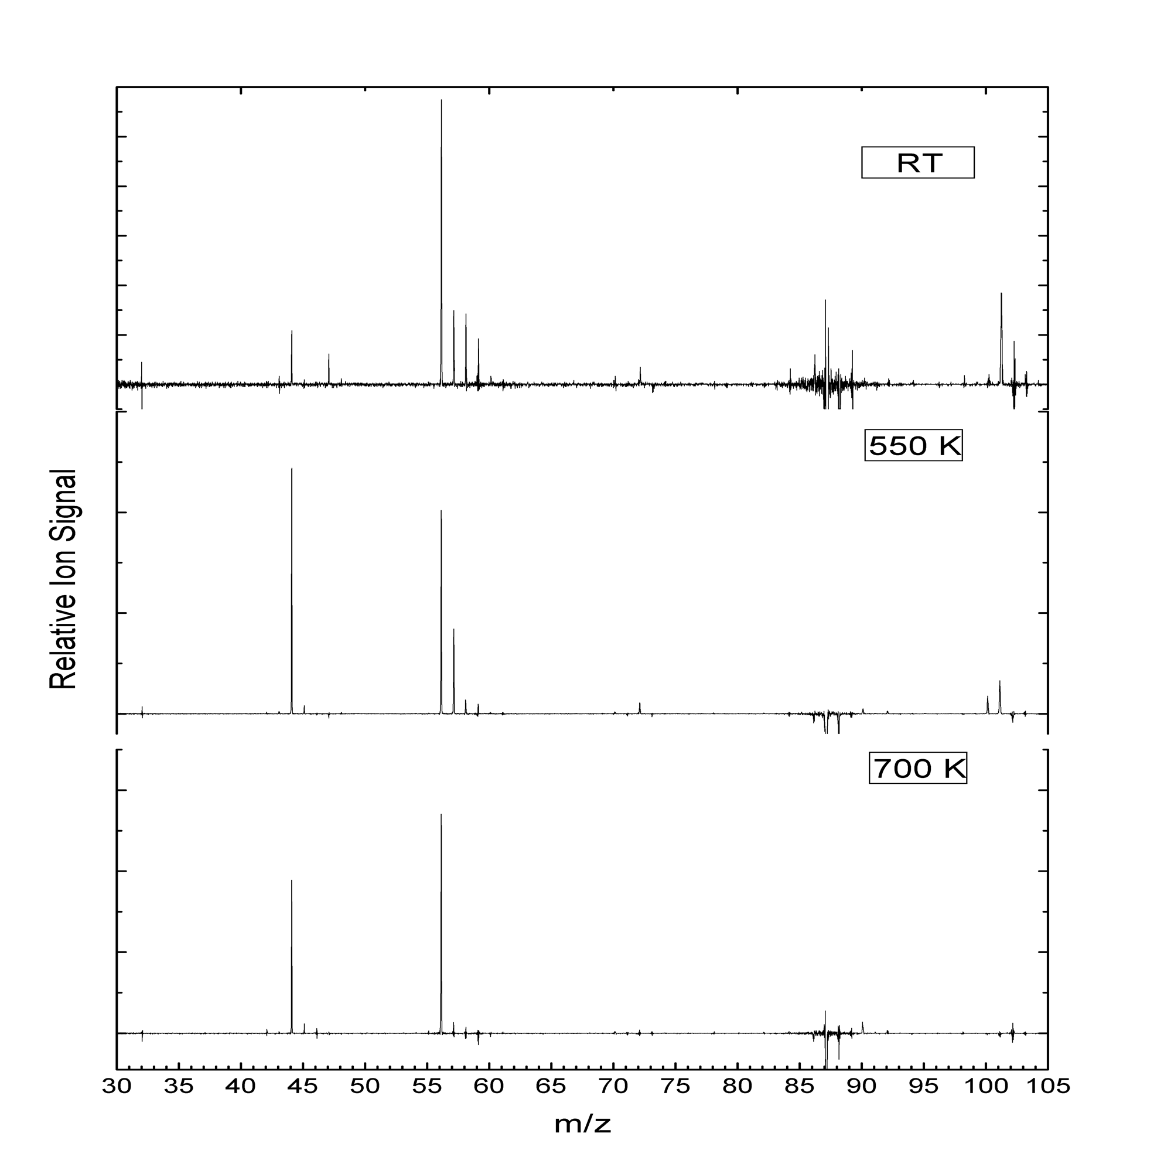
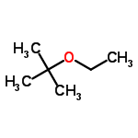
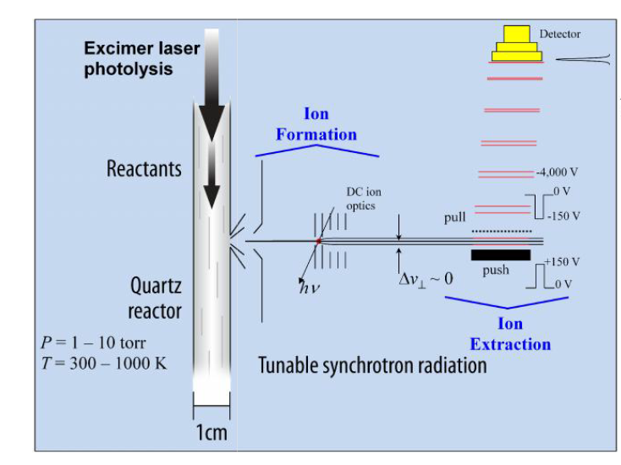
Combustion Products of Ethyl Tert-Butyl Ether using Synchrotron Photoionization
Rong Yao,¹Martin Ng¹, David Osborn,² Craig Taatjes,² and Giovanni Meloni^{1,*}
1. Department of Chemistry, University of San Francisco, San Francisco, CA 94117; 2. Combustion Research Facility, Sandia National Laboratories, Livermore, CA 94551
Results
Ethyl tert-butyl ether(ETBE)has been used as the new generation oxygenated fuel additive¹ since its favorable physical characteristics, such as low vapor pressure² and short atmospheric lifetime³. ETBE is traditionally synthesized from isobutene and ethanol⁴ which could be produced from biomass. The oxidation reaction of ETBE is very meaningful to investigate the combustion process, products and potential pollutants. The photolytically initiated oxidation reaction of ETBE was carried out at the Advanced Light Source located in the Lawrence Berkeley National Laboratory. Using the multiplex photoionization mass spectrometer data were collected at the low pressure (4 Torr) and temperature (298 – 700 K) regimes.
Product | Branching ratio relative to acetaldehyde
 | RT | 550K | 700K
m/z = 44
acetaldehyde | 1 | 1 | 1
m/z = 30
formaldehyde | 2.07 | 0.086 | -
m/z = 56
cyclobutane | 1.19 | - | -
isobutene | 0.146 | 0.644 | 0.730
acrolein | - | 0.304 | 0.334
m/z = 58
acetone | 0.495 | 0.065 | -
propanal | 0.177 | - | -
glyoxal | 0.095 | - | -
m/z = 86
2-ethoxyprop-1-ene | 0.092 | - | -
m/z = 100
VTBE | 0.038 | 0.021 | -
a)
b)
Method
Reactions are carried out using a multiplexed time-resolved mass spectrometer that is briefly described here. A more detailed description is presented elsewhere.^{5,6} A gas mixture of chlorine radical precursor and starting material reactant in excess of helium enters a 60 cm quartz reactor tube. Chlorine free radicals are generated by 351 nm excimer laser pulses at a rate of 4 Hz. Gas samples containing reaction species effuse from the reactor tube through a pinhole (650 μm diameter) to form a molecular beam which is perpendicularly intersected in the ionization chamber by synchrotron radiation selected by a 3-m monochromator. Ions are accelerated toward and detected by a time-of-flight mass spectrometer. Ion intensity (I), reaction time (t), and mass-to-charge ratio (m/z) are recorded simultaneously during the reaction. This process is repeated when the photon energy (E) is varied from 8 to 11.4 eV at increments of 0.025 eV.
c)
d)
e)
Conclusion
f)
Both the products and their branching ratios are determined by using temporal resolved plots and absolute photoionization spectra. At RT acetaldehyde, formaldehyde, cyclobutane, isobutene, acetone, and propanal are determined as the main products with branching ratios of 1.00, 2.07, 1.19, 0.15, 0.50, and 0.18, respectively. At 550 K the main products become acetaldehyde, isobutene, and acrolein with branching ratios of 1, 0.64, and 0.30, respectively. The same products as those at 550 K are observed but with different branching ratios (1, 0.73, and 0.33) at 700 K. Theoretical calculations at the CBS-QB3 level are also performed for reaction mechanism analysis, in which three reaction pathways are postulated.
g)
h)
References
1 Bartling, J.; Schloter, M.; Wilke, B.-M. Biol. Fert. Soils 2009, 46, 299.
2 Ancillotti, F.; Fattore, V. Fuel. Process. Technol. 1998, 57, 163.
3 Bennett, P. J.; Kerr, J. A. J. Atmos. Chem. 1989, 8, 87.
4 de Menezes, E. W.; Cataluña, R. Fuel Process. Technol. 2008, 89, 1148.
Taatjes, C. A.; Hansen, N.; Osborn, D. L.; Kohse-Höinghaus, K.; Cool, T. A.; Westmoreland, P. R. Phys. Chem. Chem. Phys., 2008, 10, 20-34.
Ray A. W.; Taatjes, C. A.;Welz, O.;Osborn,D.L.;Meloni,G. J.Phys.Chem.A.2012,116,6720-6730.
Figure 2. a) Mass spectra for Cl-initiated oxidation of ETBE at RT, 550, and 700 K, obtained over the photon energy range 8.0-11.4 eV. The negative peak at m/z = 87 is the main dissociative ionization fragment of ETBE（m/z =102); b) experimentally determined branching ratios at RT, 550, and 700 K relative to acetaldehyde; c) experimental PIE curve of m/z = 87 at RT; d) experimental time-trace of m/z = 87 at RT; e) experimental photoionization spectrum at RT of m/z = 44 superimposed onto the integrated PIE curve of acetaldehyde ; f) experimental time-trace of m/z = 44 at RT showing product formation; g) experimental photoionization spectrum at RT of m/z = 58 superimposed onto the integrated PIE curve of all m/z = 58 isomers ; h) experimental time-trace of m/z = 58 at RT showing product formation.
Acknowledgements
This work is supported by American Chemical Society – Petroleum Research Fund Grant # 51170 UNI6, the University of San Francisco via the Faculty Development Fund, and the Division of Chemical Sciences, Geosciences, and Biosciences, the Office of Basic Energy Sciences, the U.S. Department of Energy. Sandia National Laboratories is a multi-program laboratory operated by Sandia Corporation, a Lockheed Martin Company, for the National Nuclear Security Administration under contract DE-AC04-94-AL85000. The Advanced Light Source is supported by the Director, Office of Science, Office of Basic Energy Sciences, of the U.S. Department of Energy under Contract No. DE-AC02-05CH11231.
Figure 1. Schematic depiction of reactor tube that combines tunable synchrotron radiation with time-of-flight mass detection.

