Slide 1


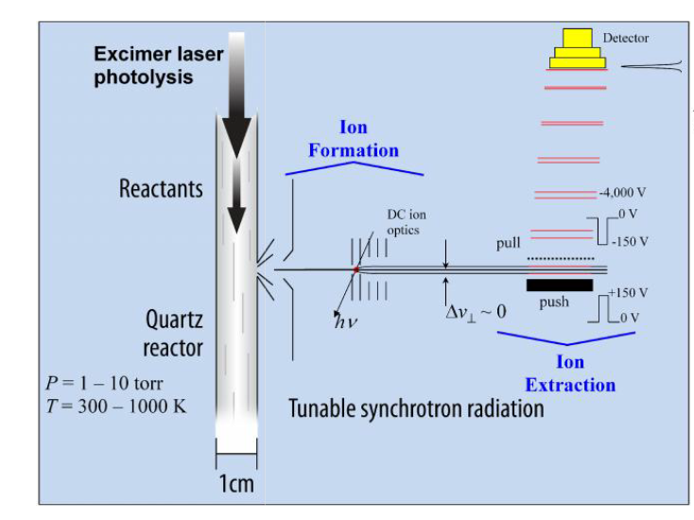
Investigation of Oxidation Reaction Products of 2-Phenylethanol
using Synchrotron Photoionization
Magaly Wooten,ª Anthony Medrano,ª David Osborn,^{b} Craig Taatjes,^{b} and Giovanni Meloni^{a*}
ªDepartment of Chemistry, University of San Francisco, San Francisco, CA 94117
^{b}Combustion Research Facility, Sandia National Laboratories, Livermore, CA 94551
Abstract
Results
Conclusion
Photolytically Cl-initiated oxidation reaction of 2-phenylethanol (2-PE) was carried out at the Advanced Light Source (ALS) in the Lawrence Berkeley National Laboratory. Using the multiplex photoionization mass spectrometer, coupled with the tunable vacuum ultraviolet radiation of the ALS, data were collected at low pressure (4 – 6 Torr) and temperature (298 – 550 K) regimes. Data analysis was performed via characterization of the reaction species photoionization spectra and kinetic traces.
a)
b)
a)
b)
Ion Signal (a.u.)
Ion Signal (a.u.)
Ion Signal (a.u.)
Introduction
Photon Energy (eV)
Time (ms)
Due to its high energy density, low volatility, and low hygroscopicity, 2-phenylethanol (2-PE) is a promising biofuel candidate.¹ 2-PE occurs naturally in the essential oils of various plans and flowers.² It is traditionally synthesized from benzene and ethylene oxide through Friedel–Crafts alkylation reaction.³ Research is underway on the production of high enough yields of 2-PE to make it economically feasible.^{4,5,6} The study of 2-PE combustion facilitates chemical kinetic modeling, important to the design of new advanced engines (e.g., HCCI), and allows for the investigation of its products and potential pollutants.
c)
d)
Figure 3. a) Experimentally determined branching fractions at 550 (with & without O₂) relative to phenylacetaldehyde; b) mass spectra for Cl-initiated oxidation of 2PE at RT and 550 without O₂.
Ion Signal (a.u.)
Ion Signal (a.u.)
Quantification of products was performed using temporal resolved plots and absolute photoionization spectra. Branching fractions and ratios were calculated for both T. Results can be seen in Fig. 2 and Fig. 3. At RT formaldehyde, acetaldehyde, toluene, and phenylacetaldehyde are determined as the main products, with branching ratios as shown in Fig. 2(g). The same products are formed at 550 K, in addition to methanol, ethanol, 1,6-heptadiyne, and styrene. At 550 K, the main product (phenylacetaldehyde) shows branching fractions of 51.8% and 73.0%, with and without O₂, respectively. A schematic for phenylacetaldehyde formation, the dominant product at both investigated T, is displayed on Fig. 2(i). It is proposed that 2-PE, after initial H-abstraction, reacts with O₂ to form a peroxy species, which isomerizes to QOOH (Waddington’s mechanism, characteristic of alcohol oxidation); phenylacetaldehyde is then formed through the removal of the HO₂ radical and formation of the C=O bond.
e)
Photon Energy (eV)
f)
Time (ms)
Apparatus
Ion Signal (a.u.)
Ion Signal (a.u.)
Reactions are carried out using a multiplexed time-resolved mass spectrometer. A brief description of the apparatus is presented here; a more detailed description is presented elsewhere.^{7,8} A gas mixture of radical precursor (Cl₂) and starting material in excess helium enters a 60 cm quartz reactor tube. Chlorine free radicals are formed through photolysis using 351 nm excimer laser pulses at a rate of 4 Hz. Reaction products effuse from the reactor tube through a 650 μm pinhole and are perpendicularly intersected in the ionization chamber by synchrotron radiation selected by a 3-m monochromator. Ions are accelerated toward and detected by a multiplex time-of-flight mass spectrometer. The process takes place at photon energies ranging from 8.0-11.0 eV with 0.025 eV increments.
Photon Energy (eV)
Time (ms)
g)
References
Atsumi, S.; Hanai, T.; Liao, J. C. Nature (London, U. K.) 2008, 451, 86.
Etschmann, M. M. W.; Bluemke, W.; Sell, D.; Schrader, J. Appl. Microbiol. Biotechnol. 2002, 59, 1.
Fahlbusch, Karl-Georg; Hammerschmidt, Franz-Josef; Panten, Johannes; Pickenhagen, Wilhelm; Schatkowski, Dietmar; Bauer, Kurt; Garbe, Dorothea; Surburg, Horst. Ullmann's Ency. of Ind. Chem. 2003.
Chen, H.; Chen, W.-q.; Zhang, J.-f. Guocheng Gongcheng Xuebao 2011, 11, 782.
Costa, M. A.; Marques, J. V.; Dalisay, D. S.; Herman, B.; Bedgar, D. L.; Davin, L. B.; Lewis, N. G. PLoS One 2013, 8, e83169/1.
Eshkol, N.; M. Sendovski M. Bahalul T. Katz-Ezov Y. Kashi & A. Fishman. J. Applied Microbiology 2009, 2, 534–542.
Czekner, J.; Taatjes, C. A.; Osborn, D.L.; Meloni, G. Int. J. Mass Spectrom. 2013, 348, 39.
Cool, T. A.; McIlroy, A.; Qi, F.; Westmoreland, P. R.; Poisson, L.; Peterka, D. S.; Ahmed, M. Rev. Sci. Instrum. 2005, 76, 094102/1.
i)
Acknowledgments
Figure 2. a) Experimental PIE curve of m/z = 120 at 550 with O₂; b) experimental time-trace of m/z = 120 at 550 with O₂; c) experimental PIE curve of m/z = 104 at 550 with O₂; d) experimental time-trace of m/z = 104 at 550 with O₂; e) experimental PIE curve of m/z = 44 at RT with O₂; f) experimental time-trace of m/z = 44 at RT with O₂; g) experimentally determined branching ratios at RT and 550 (with & without O₂); i) postulated schematic for the dominant product (phenylacetaldehyde) of 2-PE oxidation reaction.
This work is supported by American Chemical Society – Petroleum Research Fund Grant # 51170 UNI6, the University of San Francisco via the Faculty Development Fund, and the Division of Chemical Sciences, Geosciences, and Biosciences, the Office of Basic Energy Sciences, the U.S. Department of Energy. Sandia National Laboratories is a multi-program laboratory operated by Sandia Corporation, a Lockheed Martin Company, for the National Nuclear Security Administration under contract DE-AC04-94-AL85000. The Advanced Light Source is supported by the Director, Office of Science, Office of Basic Energy Sciences, of the U.S. Department of Energy under Contract No. DE-AC02-05CH11231 at Lawrence Berkeley National Laboratory.
Figure 1. Schematic depiction of reactor tube that combines tunable synchrotron radiation with time-of-flight mass detection.

